Slide 1
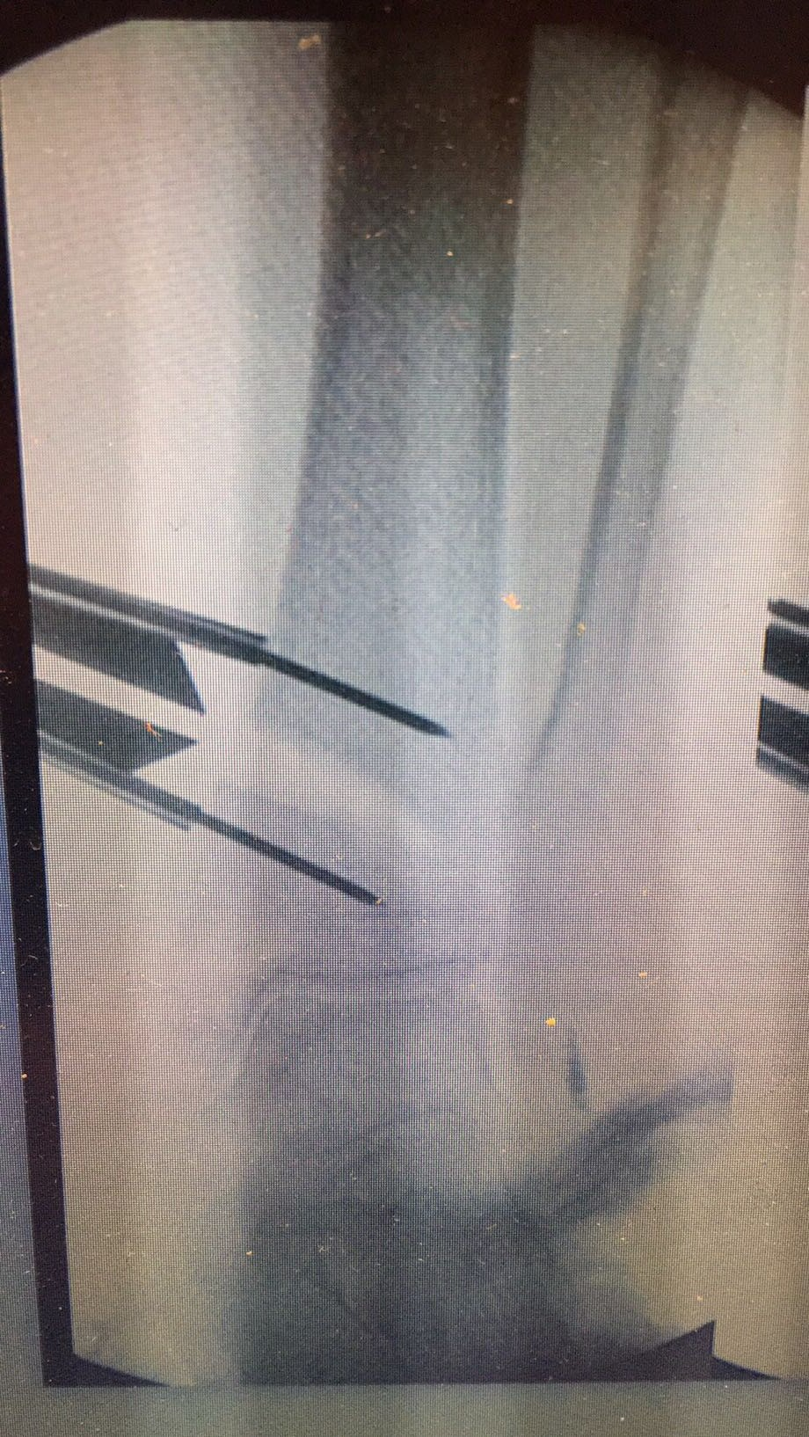
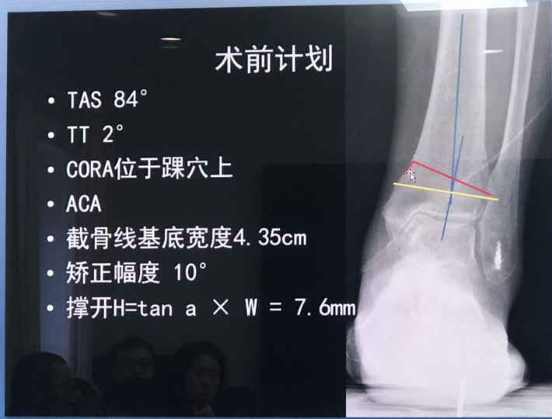



Surgery overview
Goal: align $l_{1}$ with $l_{2}$（Fig 1）
Procedure: cut the tibia along the red polyline (Fig 1) and stretch the inner side of the calf with a height H to rotate the upper part of the tibia with an angle of a (Fig 2)
The yellow line is the aim line for cutting (have to double check on which side they start to cut)
$$l_{1}$$
$$l_{2}$$
H
W
Fig 1
a
Fig 2

